Slide 1
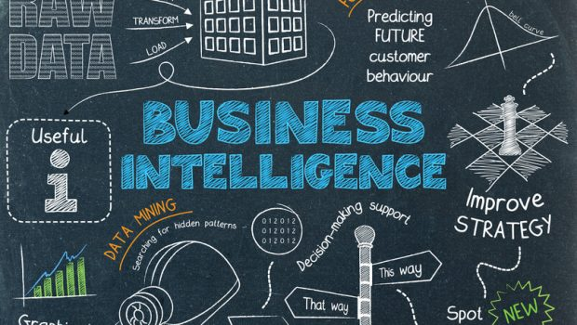
Business Intelligent
Group Presentation
Present By:
SHALOMSHAN & JAMSITH

Slide 2

Agenda
What is Business intelligence (BI)?
Suitable Example for BI
Lotte.com: BI Increases Company Revenue
Cementos Argos: BI Improves Financial Efficiency
Baylis & Harding: BI Provides Decision Making Process Support
List of BI Tools
Tableau
Qlik
Microsoft Power BI
Dandus BI
Sisense
Conclusion

Slide 3

What is Business intelligence (BI)?
Business intelligence (BI) is about getting the right information, to the right decision makers, at the right time.
BI is an enterprise-wide platform that support reporting, analysis and decision making

Slide 4

Suitable Example for BI
Lotte.com: BI Increases Company Revenue
Cementos Argos: BI Improves Financial Efficiency
Baylis & Harding: BI Provides Decision Making Process Support

Slide 5

Lotte.com: BI Increases Company Revenue
Challenge: with more than 1 million site visitor daily, company executives wanted to understand why customers abandon shopping carts.
Solution: The assistant general manager of the marketing planning team implemented customer experience analytics; the first online behavioral analysis system applied In Korea. The manager used the information used the information to understand customer behavior and implement targeted marketing and transform the website.
Results: With the insights from the new BI analytics program, there was increase in customer loyalty after on year and an increase of $10 million in sales. The changes came from identifying the causes of shopping cart abandonment such as a long checkout process and unexpected delivery times and remedying the situation.

Slide 6
Cementos Argos: BI Improves Financial Efficiency
Challenge: The company looked for an overall competitive advantage and a way to support better decision-making.
Solution: Cementos Argos created a dedicated business analytics center. The company invested in experienced business analysts and data science teams and used BI to leverage data.
Result: The company standardized the finance process and applied big data to gain more in-depth insight into customer behavior which yielded a higher profitability level.

Slide 7

Baylis & Harding: BI Provides Decision Making Process Support
Challenge: The company needed to give managers and executives greater visibility into financial, customer and sales data to make better decisions and expand the business.
Solution: Managers and executives used business intelligence tools to create standard and ad hoc reports.
Results: Company executives and managers now have instant access to the business data they need to act proactively. They can create custom dashboards with KPIs relevant to their areas of focus and share the goals and performance details with their teams without having to request a custom report from IT.

Slide 8

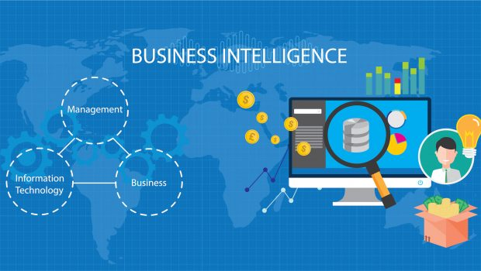
List of BI Tools
Tableau
Qlik
Microsoft Power BI
Dandus BI
Sisense

Slide 9

Tableau
Tableau Develop Organization: Data Visualization Company
Features of Tableau:
Tableau Dashboard
Collaborating & Sharing
Live & In memory Data
Data sources in Tableau
Advanced visualizations
Maps
Robust Security
Mobile view
Ask data
Trent data & Predicative analysis

Slide 10
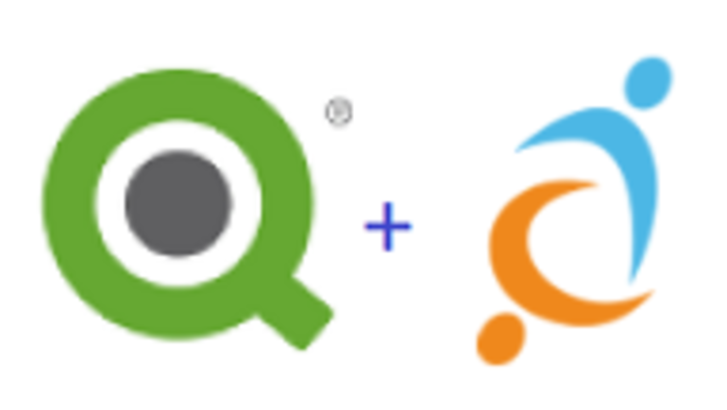
Qlik
Qlik Develop Organization: Qlik
Features of Qlik:
Natural analytics and data discovery
Data collaboration and connectivity
Mobility and scalability
Social data discovery
Enterprise platform capabilities
Interactive guided analytics
In-memory storage technology
Agile application development
Associative model
Comparative analysis

Slide 11


Microsoft Power BI
Microsoft Power BI Develop Organization: Microsoft
Features of Microsoft Power BI:
Range of Attractive Visualizations
Get Data (Data Source)
Datasets Filtration
Customizable Dashboards
Flexible Tiles
Navigation Pane
Informative Reports
Natural Language Q & A Question Box
DAX Data Analysis Function
Help & Feedback Buttons

Slide 12

Dandus BI
Dandus BI Develop Organization: Qlik
Features of Qlik:
Dashboards
Communication and Collaboration Tools
Slideshows
Data Visualizations
Superb Interactivity
Rich, Interactive Scorecards
Tables
Charts
Gauges
Maps

Slide 13

Sisense
Sisense Develop Organization: Sisense
Features of Qlik:
Integrates with web portals
Use Single-Sign-On to keep a single authentication mechanism
Exports data to CSV, PDF, Excel, Images and other formats
Interactive browser-based dashboards
Eye-grabbing visualization
Removes limitations to data size
Filters data by dropping fields on the canvas
Wide range of widgets such as gauges, charts, and graphs
Embed entire dashboards or individual widgets
Data unification

Slide 14


Slide 15

Thank You

